Slide 1

Ramrao Adik Institute of Technology
Department of Computer Engineering
SE MINI Project Mock 1 Presentation
On
“Creating Audio Book Using Python”
By
Roll No. Name of Students
19CE1076 Pranav Kokate
19CE1110 Prakash Vallal
19CE1042 Ms. Puja Padiya Suprith KS
19CE1007 Nikhil Jamdar
Guided by

Slide 2
Project Presentation Schedule
Mock 1 :- 05/03/21
Mock 2 :- 29/04/21
Final Presentation :- 27/05/21

Slide 3
Outline
Introduction
Current Available Solution
Issues in Current Solution
Problem statement
Technologies and methodologies
System Design
Process Diagram
Implementation
Conclusions
Future Work
References
2

Slide 4
Introduction
Audiobooks are voice recordings of the text of a book that you listen to rather than read. Audiobooks can be exact word-for-word versions of books or abridged versions.
You can listen to audiobooks on anytime and anywhere with help of smartphone, tablet, computer, home speaker system, or in-car entertainment system.

Slide 5
Current Available Solution
Audiobooks can be a separate app service or an in-app service. If you have a Kindle Paperwhite, Audible, Amazon’s audiobook service, comes as an in-app service. However, most audiobook apps are separate services from eBook libraries.
Most audiobook services are available for download on the Apple App Store and Google Play Store. Additionally, most of these audiobook services offer a month’s worth of free trial before the app asks the users to get a premium subscription for them to have continuous access to their library.

Slide 6
Issues in Current Solution
In the current audiobook services ,for better experience we need to pay for it.
Not all books can be present in a single service. But if you download an eBook that can be converted into an audio file using our system.
.

Slide 7
Problem statement
Reading stories or essays or any text can be arduous, however an audio reading of the text is convenient and doesn’t require as much concentration as reading requires. Not all people can read some are illiterate or maybe blind, For such problem the solution is to create an application that can covert pdf to read able text, to convert text to audio. This program scans page(s) of PDF and reads the text to the user in audio. While this project is good for simple text reading
User can choose between ,to create an audio file or listen to audio files which are already present

Slide 8
Technologies and Methodology
The software libraries required to run this :
Tkinter :- For gui
Fitz :- To read the pdf and to extract text from pdf
gTTS :- Google text to speech (for conversion of text to audio file)
Pytesseract :- For OCR(Optical character recogination)
Pillow and pdf2image:- To extract images from pdf
Pygame.mixer :- For playing audio file
Requirements:-
Python, Windows 10, Visual Studio Code, Internet.

Slide 9
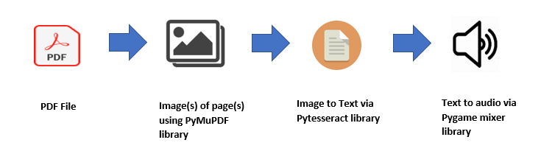
System Design
System contains of 4 modules:-
Extracting text from readable PDF.
Extracting text from image using OCR where images are extracted from the PDF.
Conversion of text to audio.(gTTS)
Playing the audio file.(pygame.Mixer)

Slide 10
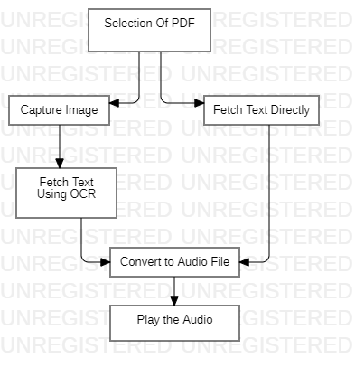
Process Diagram

Slide 11
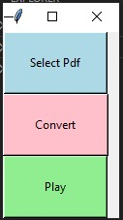
Implementation
1st time implementation.

Slide 12
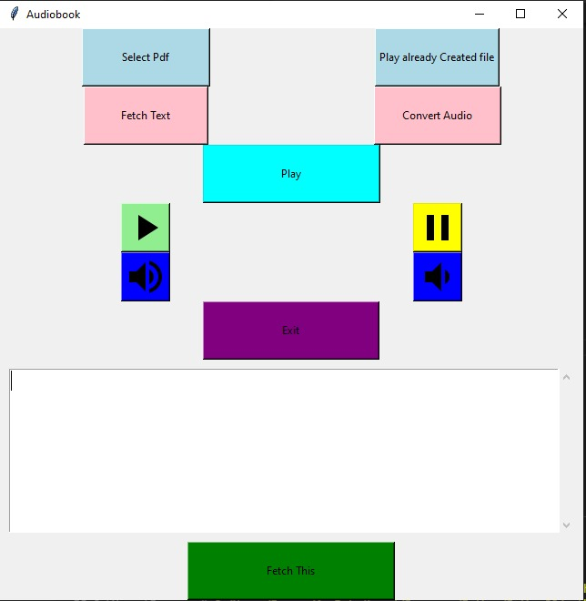
Implementation Contd.
Implementation after some modification and using gTTS for conversion of text to audio.

Slide 13
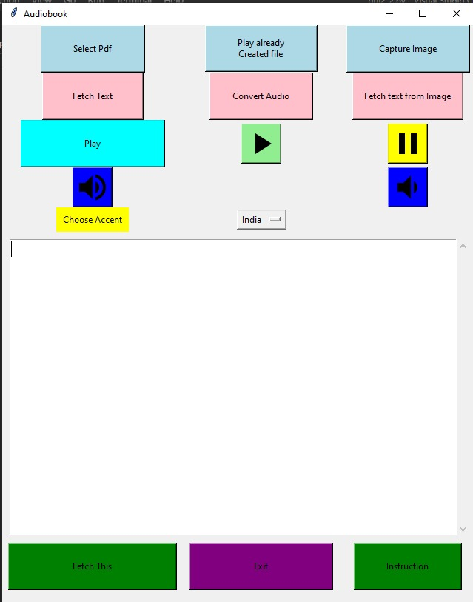
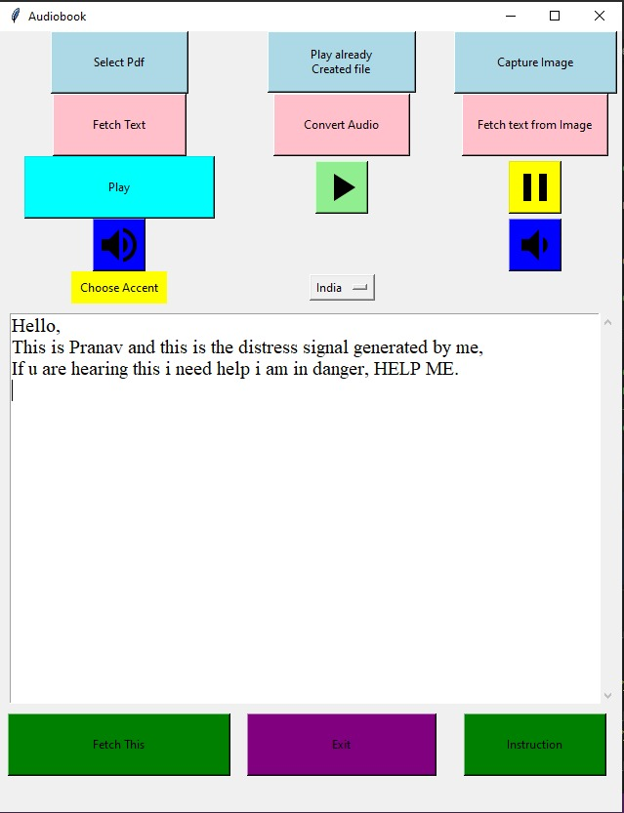
Implementation Contd
Implementation of PDF to image and extracting text using OCR.

Slide 14
Conclusions
It was seen that the code performs really well in reading straight forward PDF text files, however, if equations are involved in the text, then the reader cannot properly read the equations. Hence, the code is good for simple text but not for scientific papers as it will fumble reading the equations. However, text will be read just fine.
Any book which has more than 5000 words will be converted only once and then the users ip address would get a temporary ban from gTTS servers. So it is recommended have words less than 5000.

Slide 15
Future Work
This program can be extended to make a user friendly interface .
Making our own text to speech synthesizer to replace gtts and get rid of one of the drawbacks.
Using cv library in python for image processing for better ocr results.
System will have a slidebar to navigate through audio.
Facility to create a playlist and ,it will have categorized according to the types of books(like financial , psycological , biography)

Slide 16
References
https://github.com/shayanalibhatti/Designing-a-PDF-Audiobook-using-Python/projects
https://towardsdatascience.com/build-your-own-audiobook-in-7-lines-of-python-code-bfd805fca4b1
https://dev.to/mustafaanaskh99/convert-any-pdf-file-into-an-audio-book-with-python-1gk4

Slide 17

Thank You

